Slide 1

Intro to Baskerville
EPSRC Tier 2 HPC System
University of Birmingham

Slide 2
Overview
How can High Performance Computing benefit you?
Connecting to Baskerville
System Architecture
Running jobs using SLURM
Accessing software applications
Transferring files to/from Baskerville
Final Task: Running a job with GPUs

Slide 3
1. How can High Performance Computing benefit you?

Slide 4

High Performance Computing (HPC) typically involves connecting to very large computing systems elsewhere in the world.
These other systems can be used to do work that would either be impossible or much slower on smaller systems.
HPC resources are shared by multiple users.
The standard method of interacting with such systems is via a command line interface.

Slide 5
2. Connecting to Baskerville

Slide 6
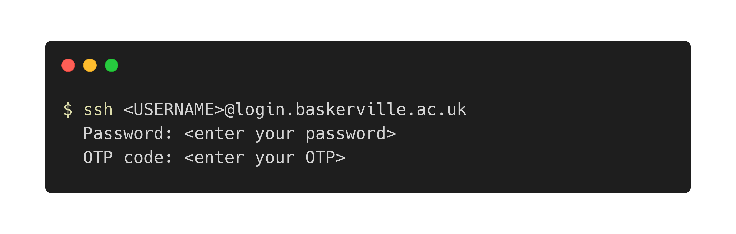
Connect using an SSH Client.
Windows: PuTTY | MobaXterm | Windows Subsystem for Linux
MacOS or Linux: Terminal
Note: OTP – One Time Passcode

Slide 7

Projects and QoS
Once you are connected to a login node, run
to see information about your Baskerville projects and available QoS.
This information is also available at admin.baskerville.ac.uk/.
Notes:
Projects are created by the PI. Used to account for time used on the cluster.
Notice that once you are connected, the command line prompt has changed to show your username, hostname, and current working directory

Slide 8
3. System Architecture

Slide 9




Local: Your computer
Remote: Baskerville
you are here
LOGIN NODE
COMPUTE NODE
QUEUE
SSH
SLURM
STORAGE
Notes:
52 Compute nodes X 4 GPUS = 208 GPUs total
5400 TB Storage
Compute should only run on a compute node (through a batch/interactive job) and never on a login node

Slide 10
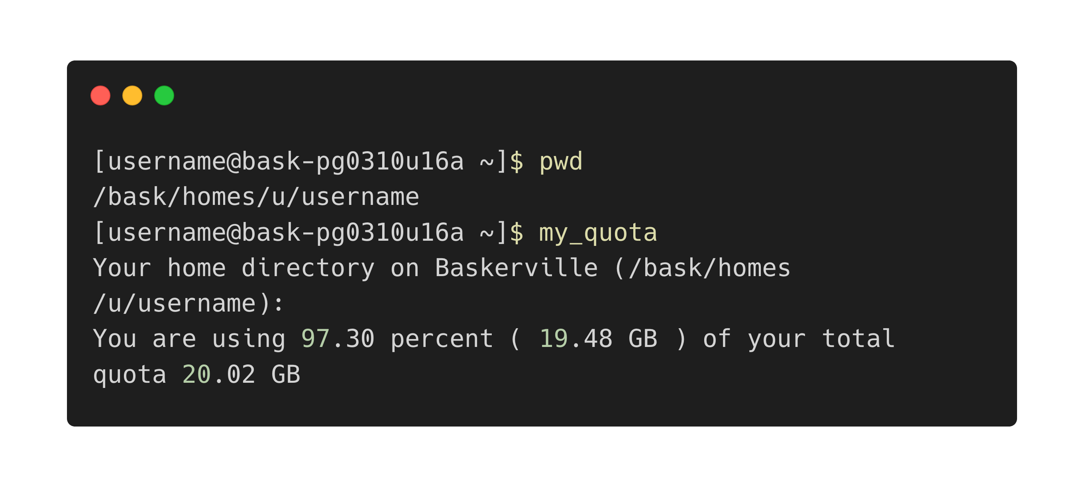
Your home folder | 20GB

Slide 11
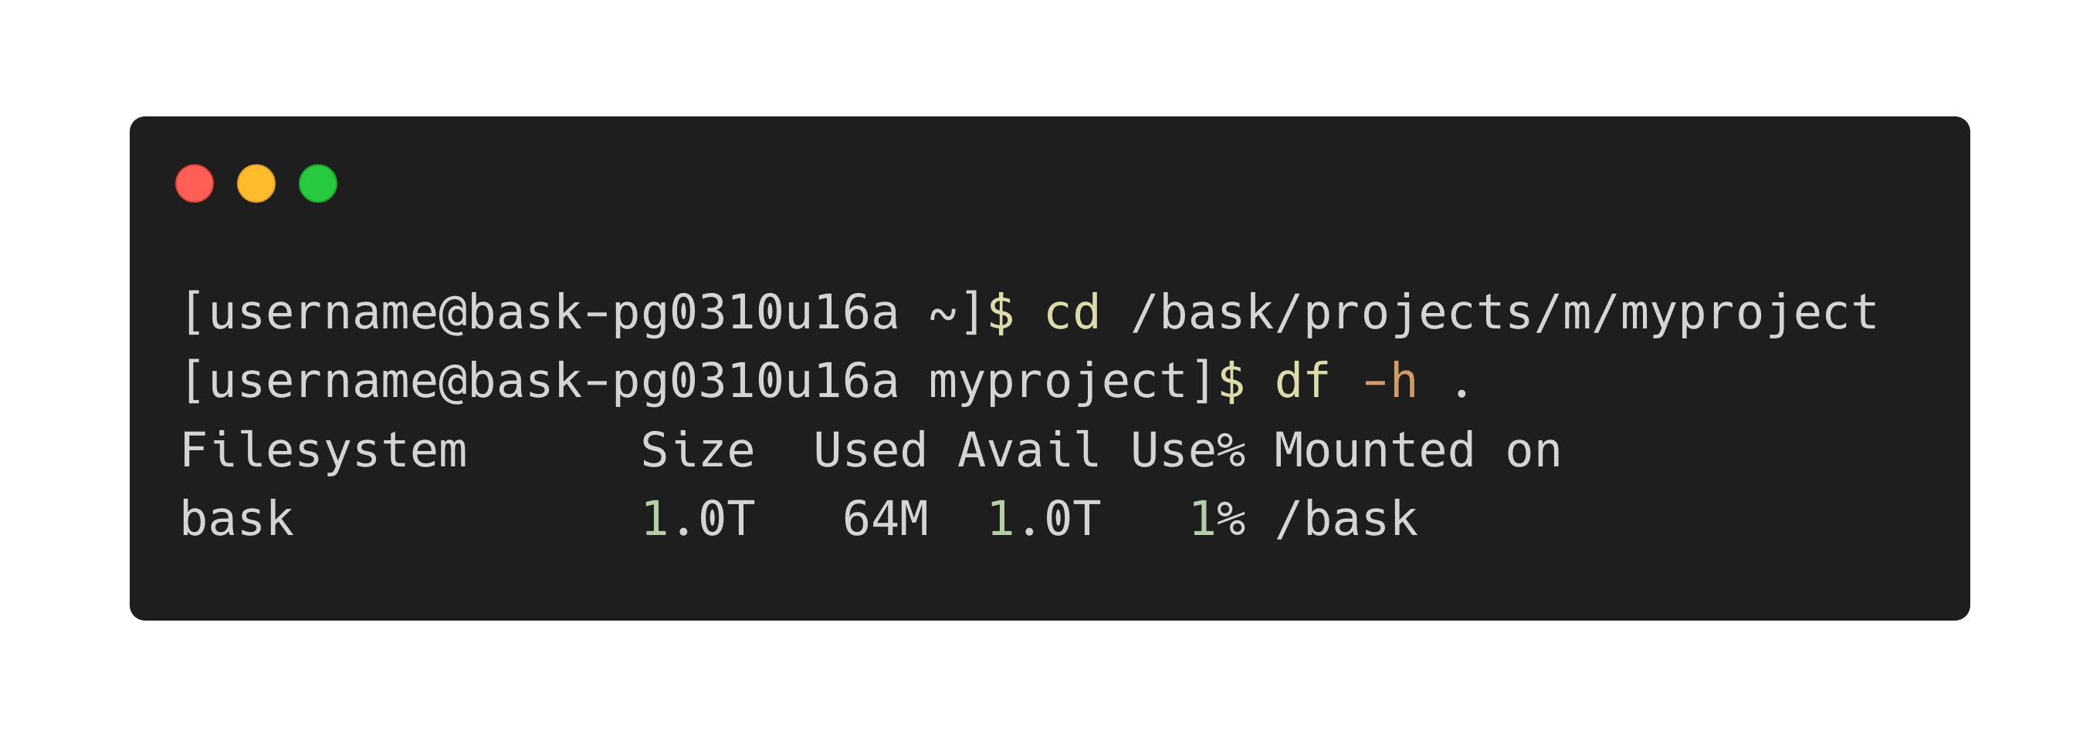
Your project folder | 1TB

Slide 12
4. Running Jobs using SLURM
Notes:
Simple Linux Utility for Resource Management

Slide 13

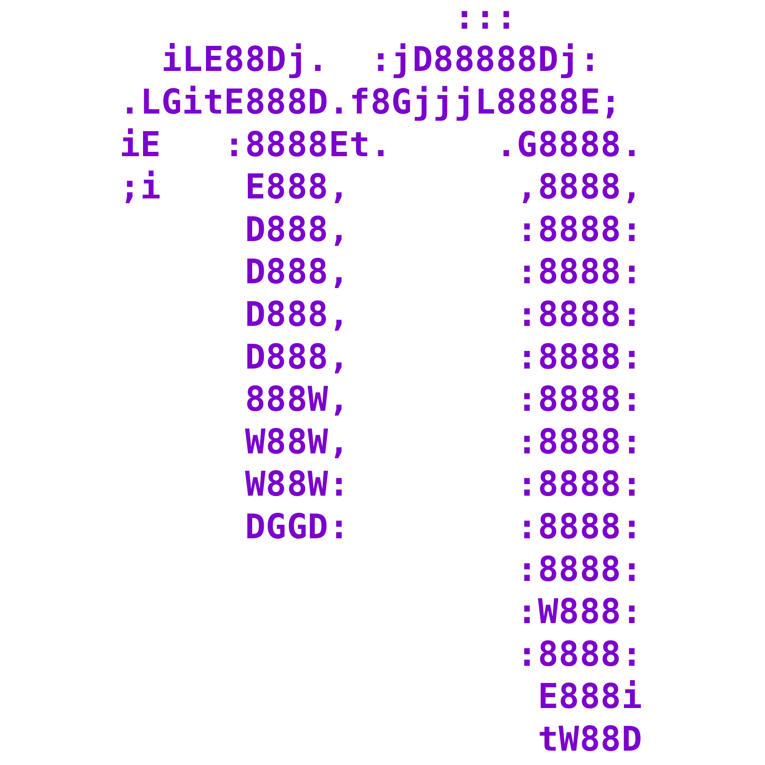
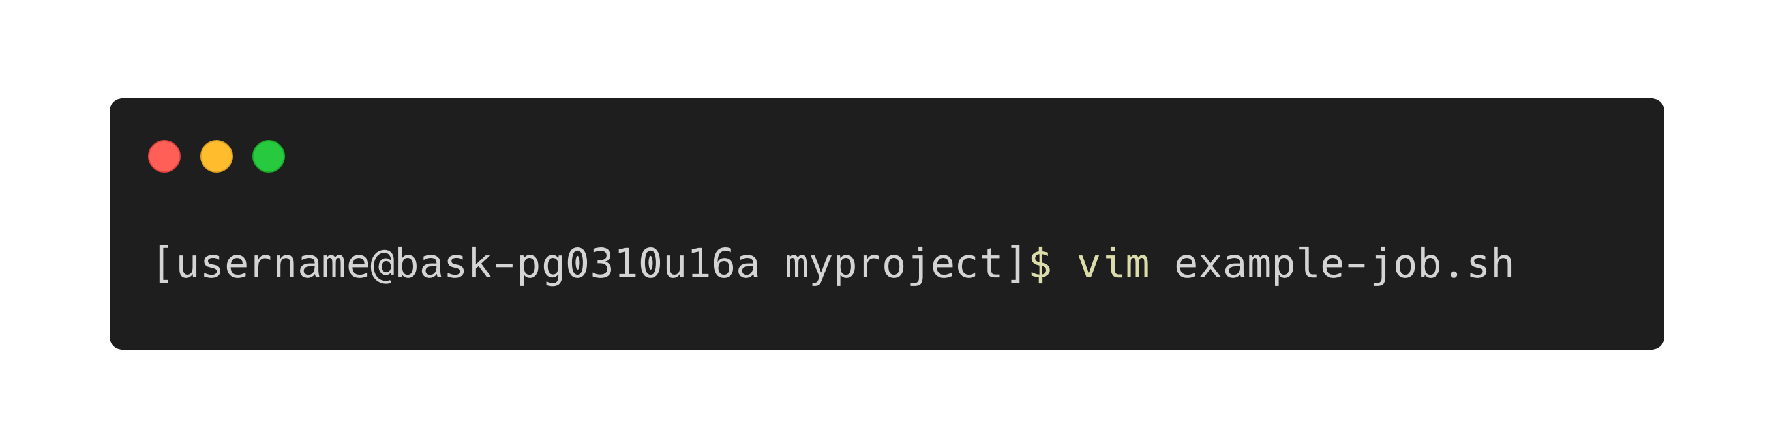
Choose your editor
vim
nano

Slide 14
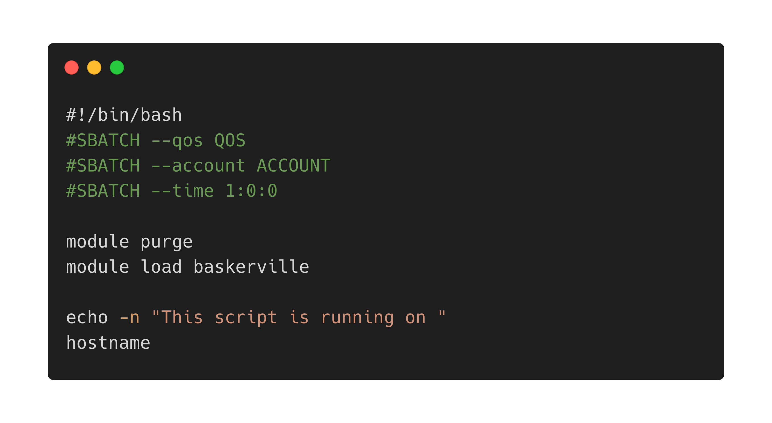
Create your job script
<ESC> :wq <ENTER> to write and quit vim
Notes:
Shebang: use bash shell
Header: resource requests
Body: commands to execute
module loading will be addressed in the next section
echo –n : flag suppresses \n

Slide 15
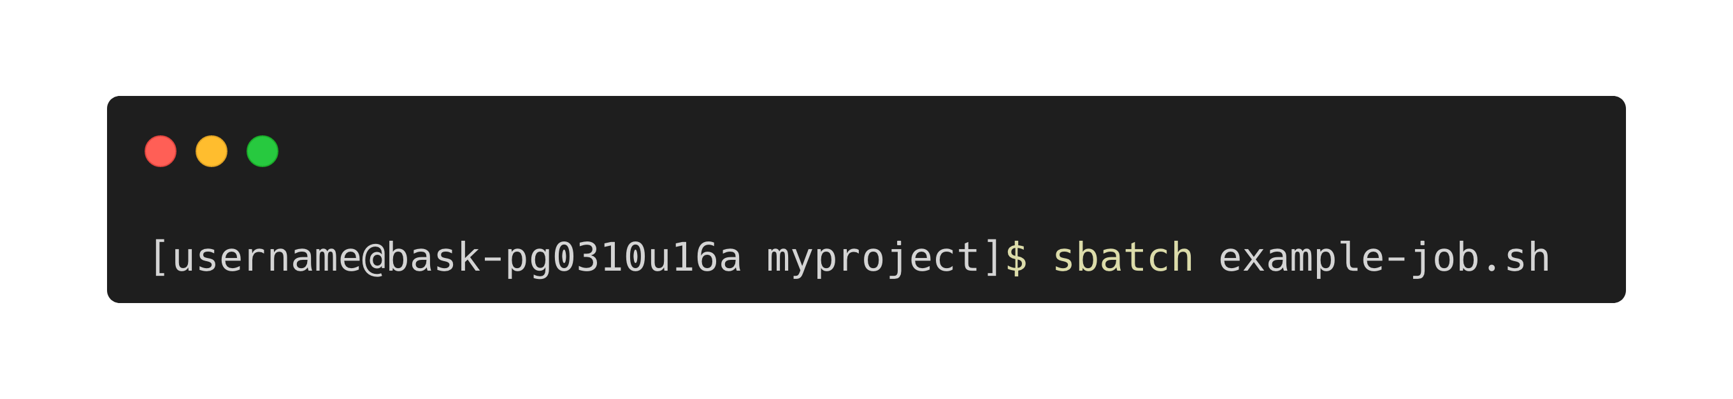
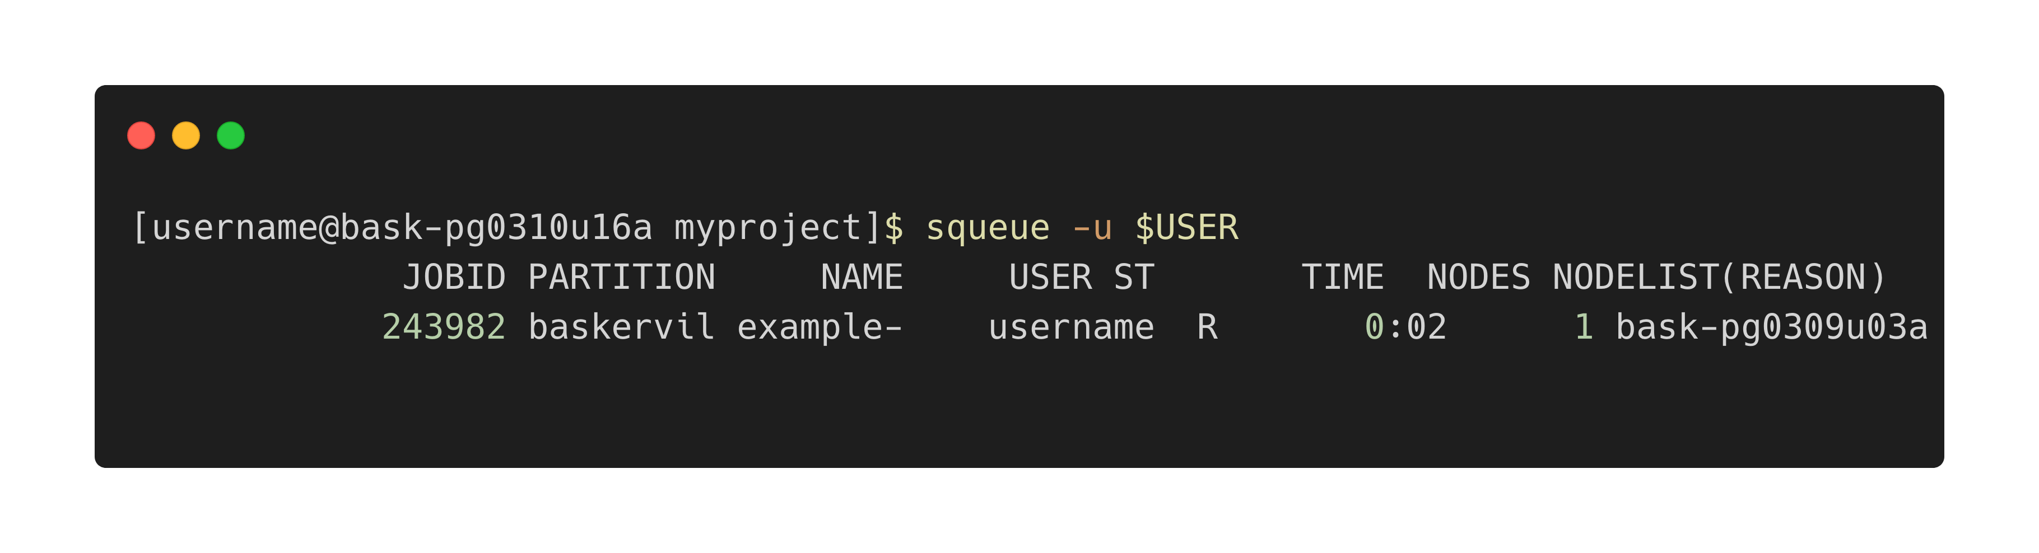
Submit your job script
Check your job status
Notes:
Highlight the jobid, needed for scancel later
Status: PD – pending (e.g. waiting for resources, priority, or requested node is down), R – running, CG – job is finishing,

Slide 16
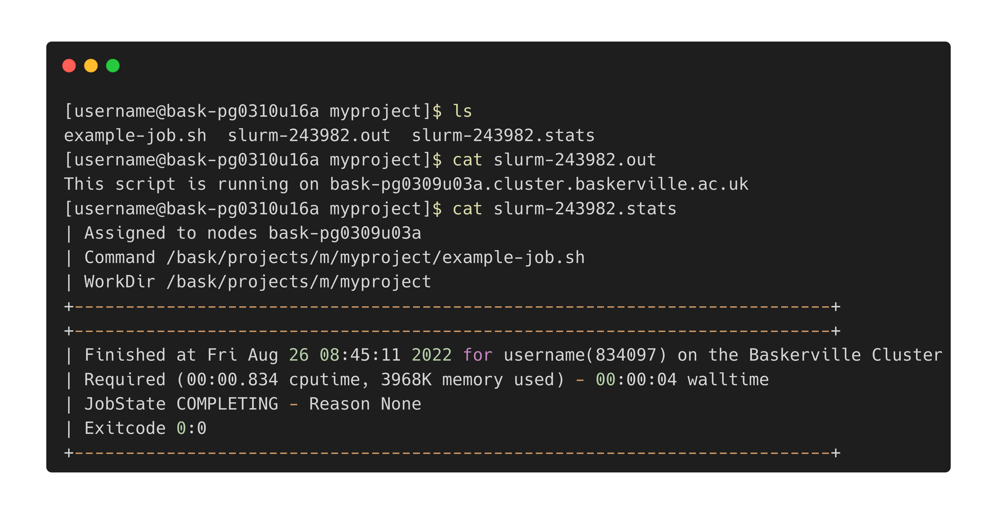
View your job outputs
Notes:
cat concatenate
Job hostname is the name of the compute node and not the login node.

Slide 17
Your turn
https://github.com/baskerville-hpc/intro-to-baskerville
Add the line sleep 5h before the echo in your job script and submit your job. How do you cancel the job? Hint: use the command scancel <jobid>
What happens if you sleep 120 and request a wall-time job of 1 minute?

Slide 18
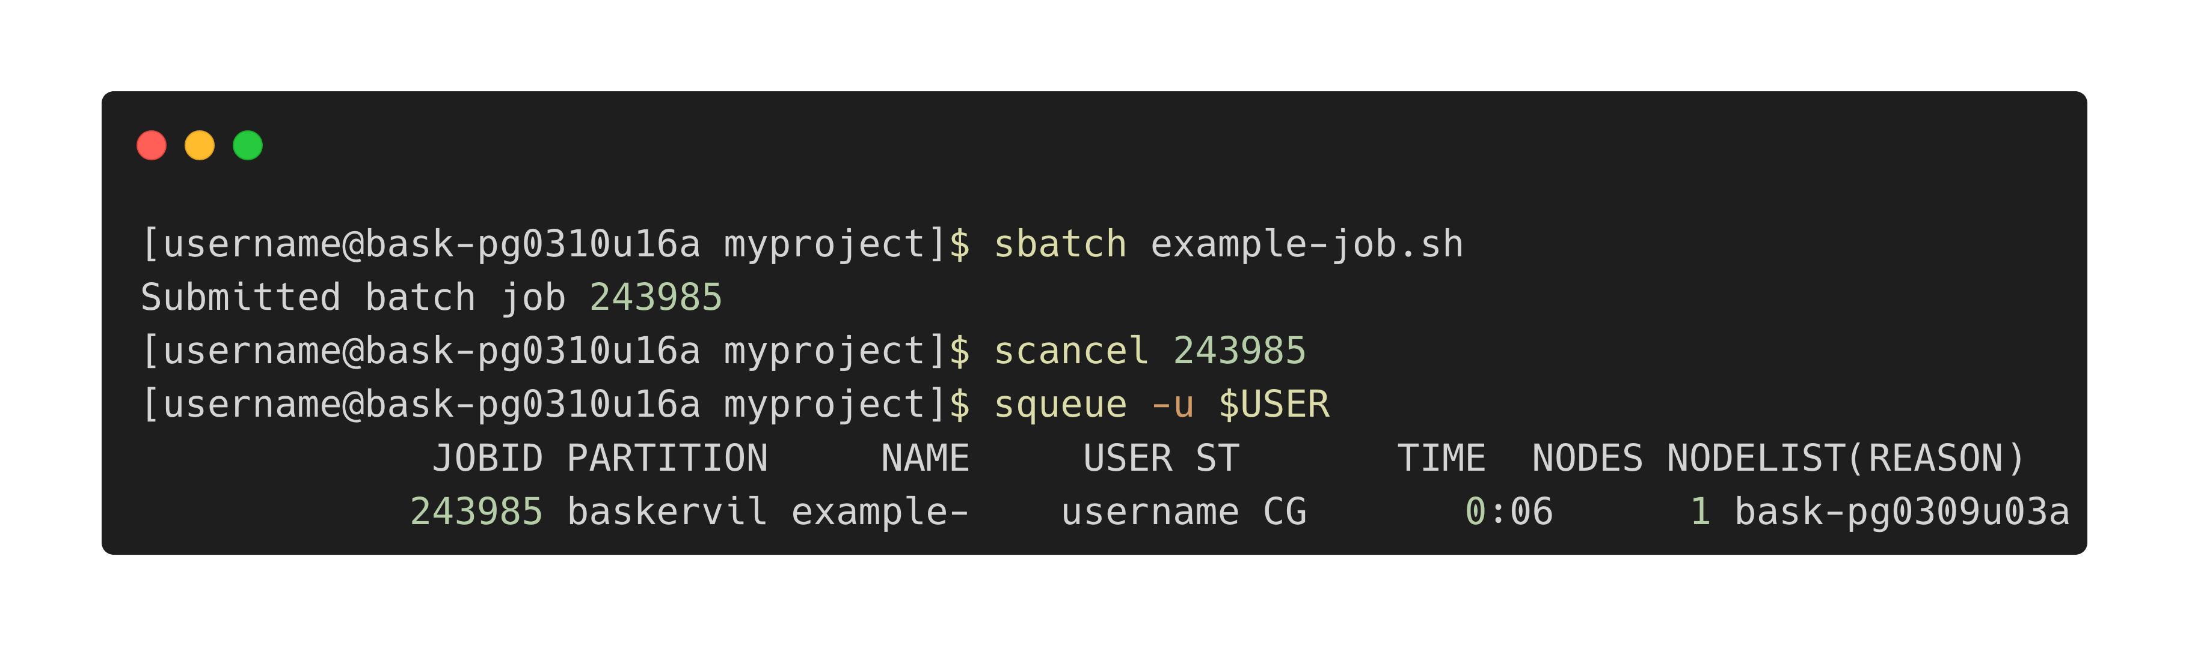
Your turn
https://github.com/baskerville-hpc/intro-to-baskerville
Add the line sleep 5h before the echo in your job script and submit your job. How do you cancel the job? Hint: use the command scancel <jobid>

Slide 19
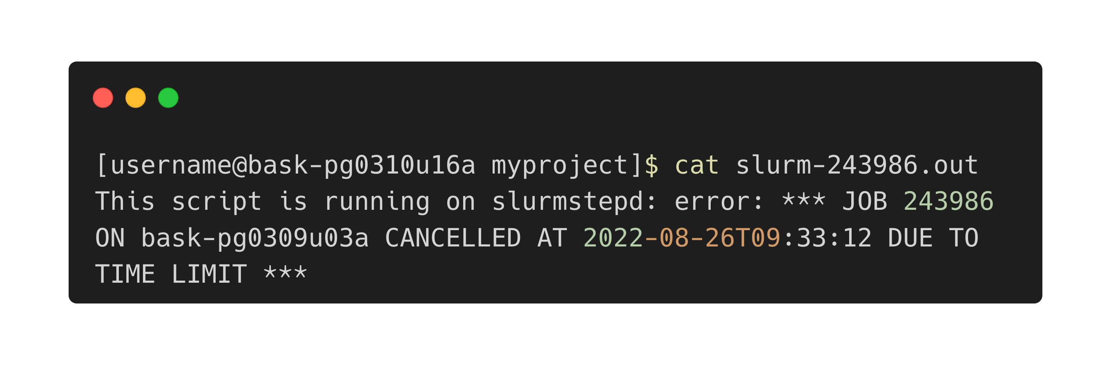
Your turn
https://github.com/baskerville-hpc/intro-to-baskerville
What happens if you sleep 120 and request a wall-time job of 1 minute?

Slide 20
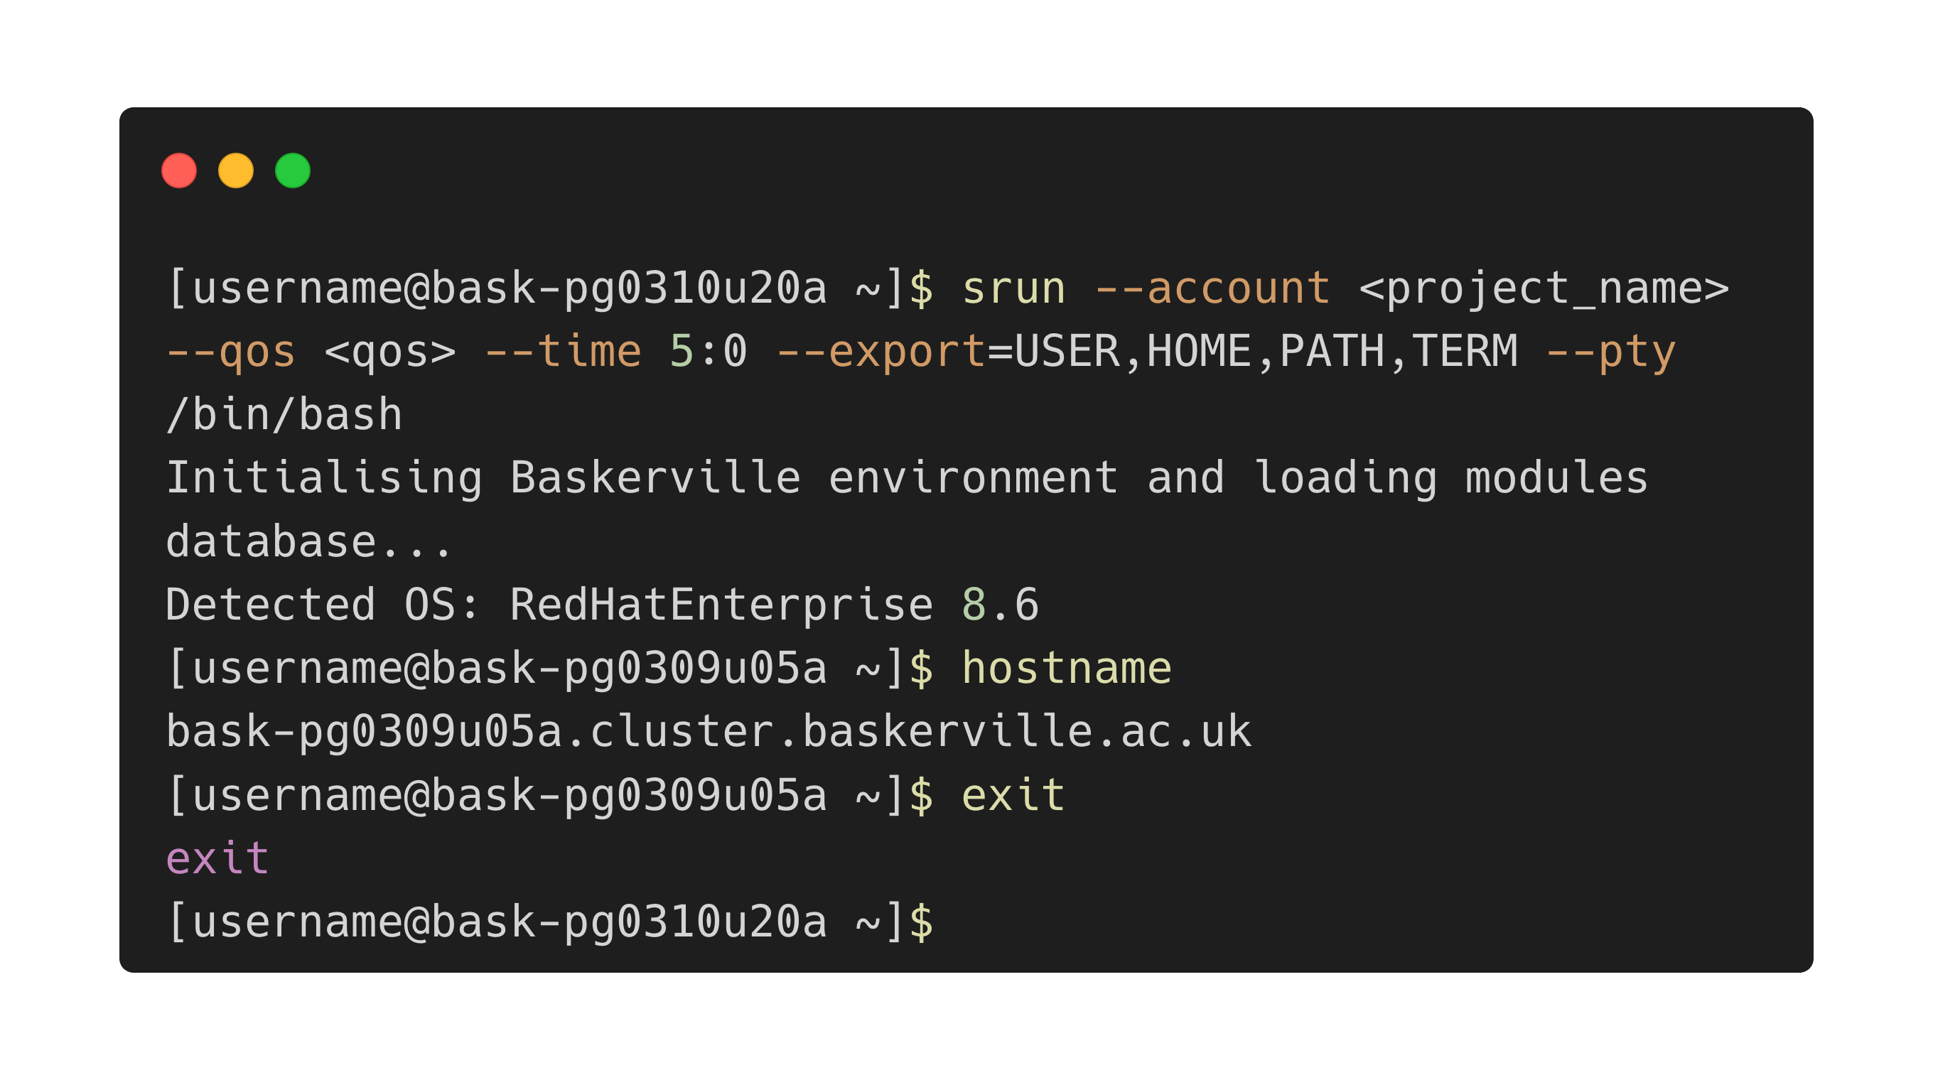
Interactive jobs
Notes:
srun submit command to run on allocation
--pty pseudo terminal command
/bin/bash command to launch a bash shell
exit as soon as your job – please don’t leave a job idle, it’s your responsibility to disconnect and make good use of resources

Slide 21
5. Accessing Software Applications
Notes:
Simple Linux Utility for Resource Management

Slide 22
Let’s look at your job script again
module purge unloads and loaded modules and resets the environment
module load baskerville loads the default Baskerville environment
Notes:
A module is a self-contained software package and includes required dependences. They are optimized for use on Baskerville.

Slide 23
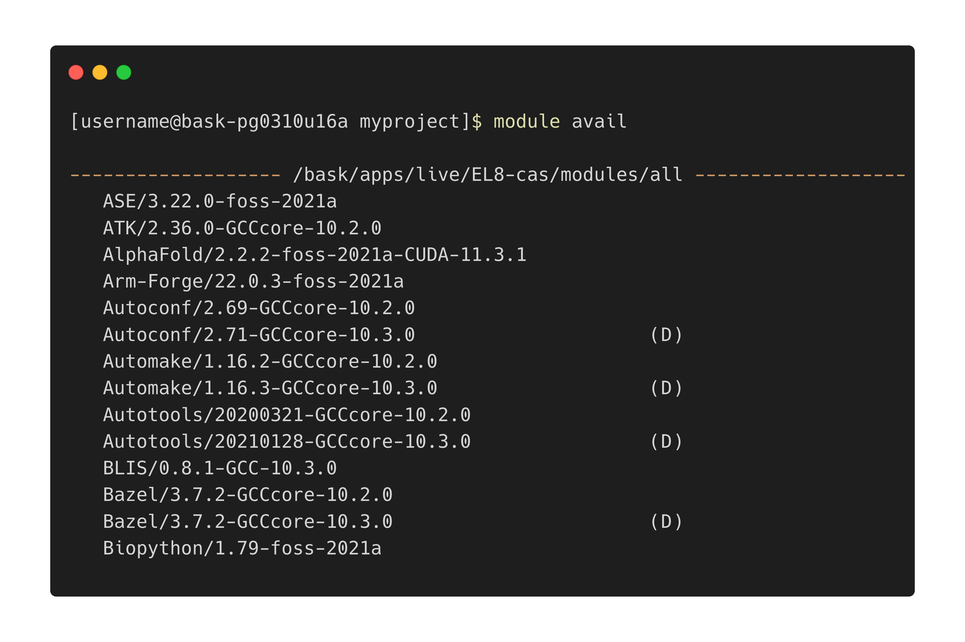
List available modules
This information is also available at apps.baskerville.ac.uk

Slide 24
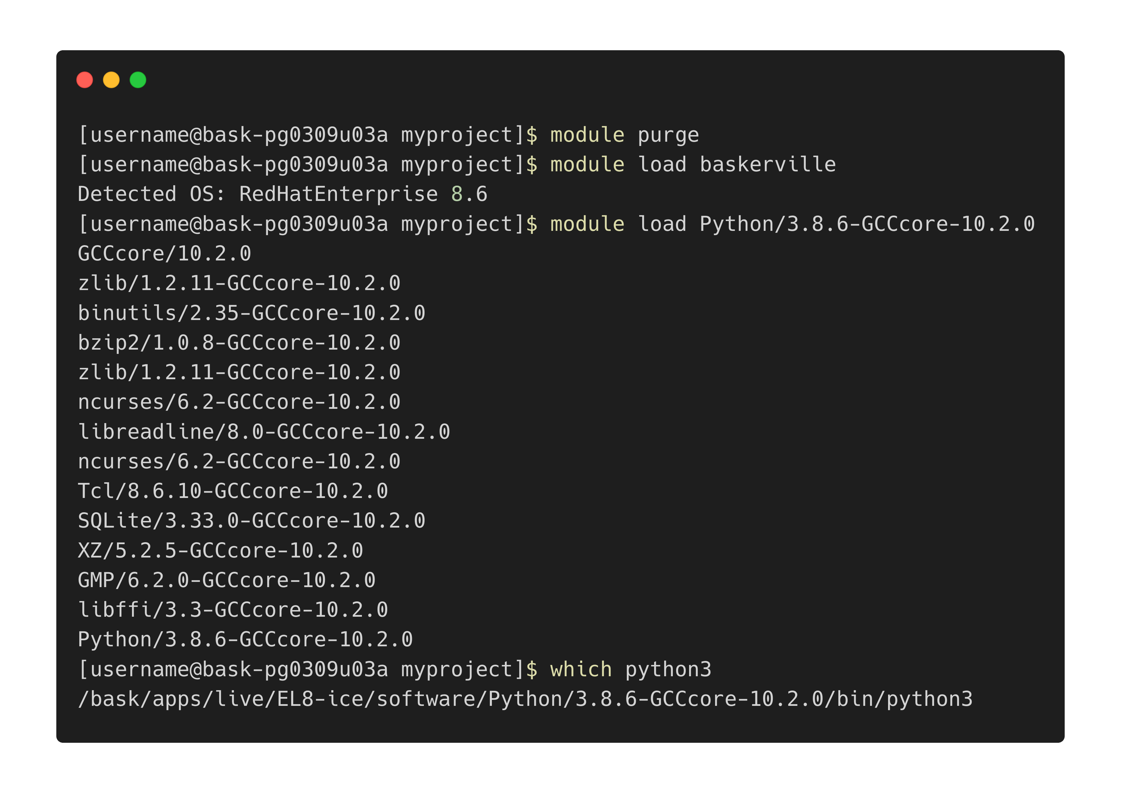
Load Python module
Notes:
Note: module loading will only take place on a compute node (either in an interactive or batch job) and not on a login node

Slide 25
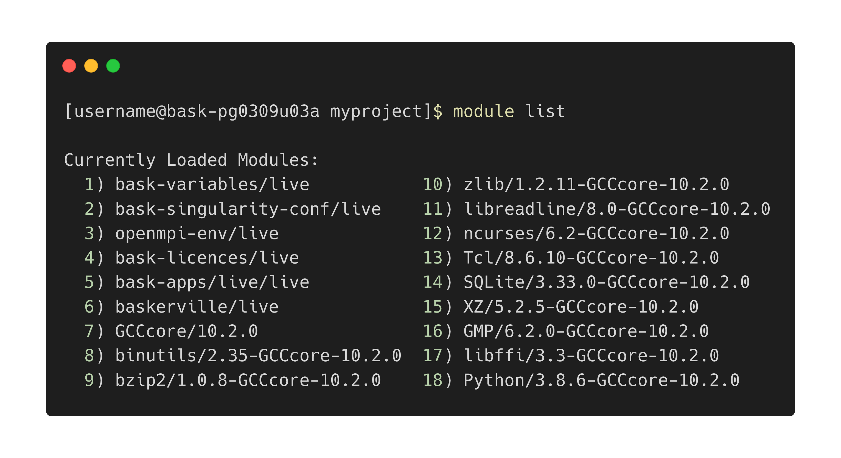
View loaded modules

Slide 26
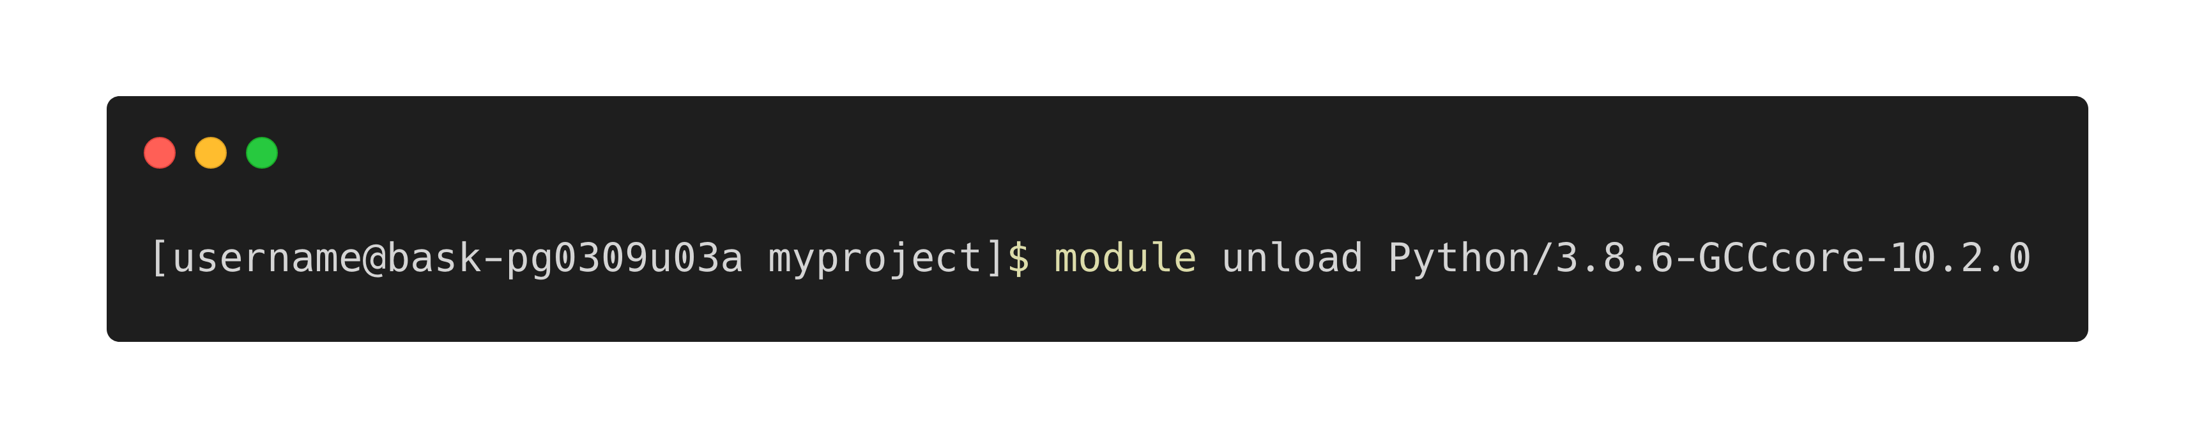
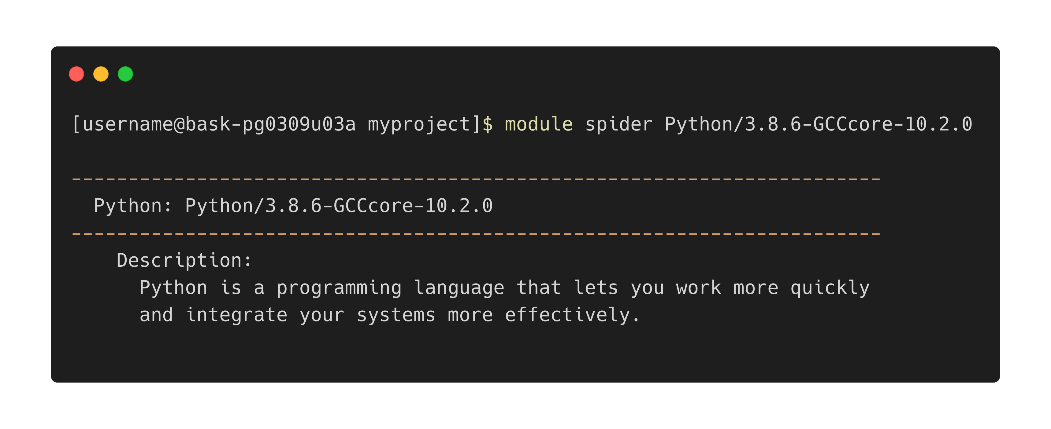
Unload Python module
View module details

Slide 27
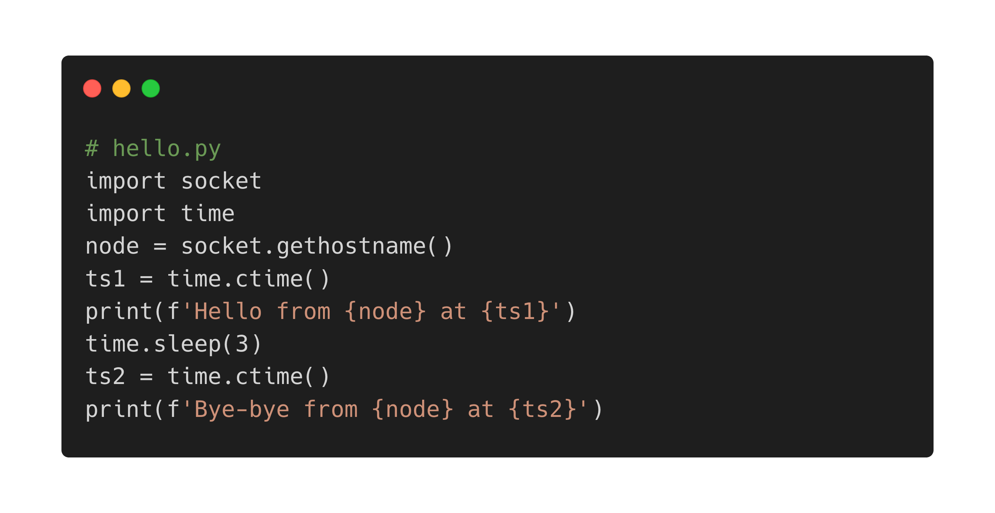
Your turn
https://github.com/baskerville-hpc/intro-to-baskerville
Create a Python script called hello.py that contains
Write a job script that loads a Python module and executes the command python hello.py
Submit and run the job

Slide 28
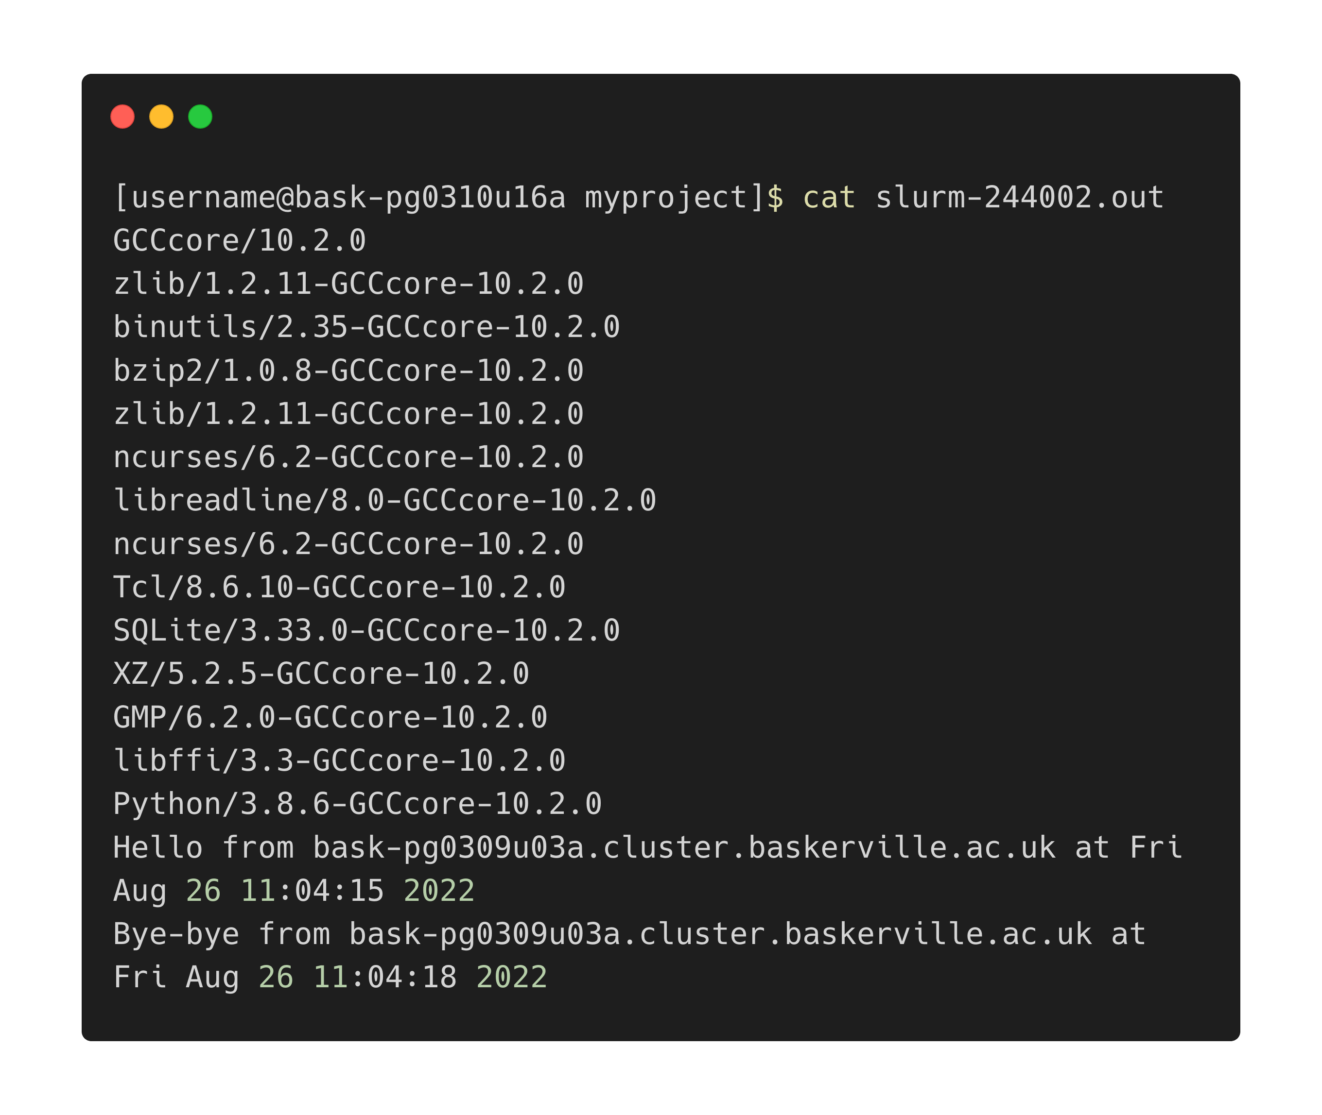
Your turn - Result
https://github.com/baskerville-hpc/intro-to-baskerville

Slide 29
6. Transferring files to/from Baskerville

Slide 30
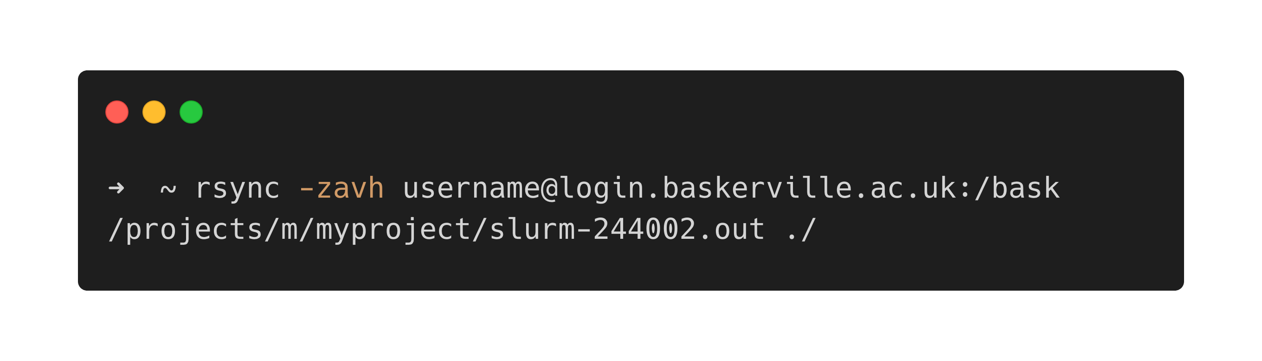
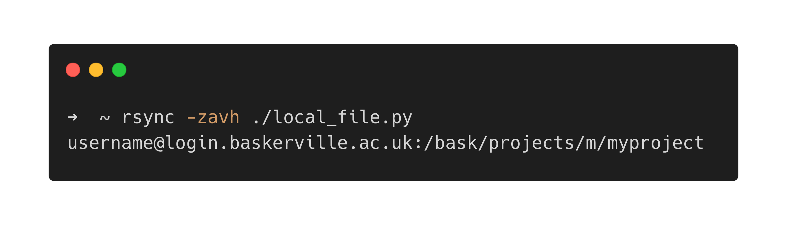
Baskerville → Local Machine
Local Machine → Baskerville
Notes:
Do this in a local Terminal window!
Note the “:” after the address where the file path is specified
z - compression
a - archive (to preserve timestamps and permissions)
v - verbose
h - human readable

Slide 31
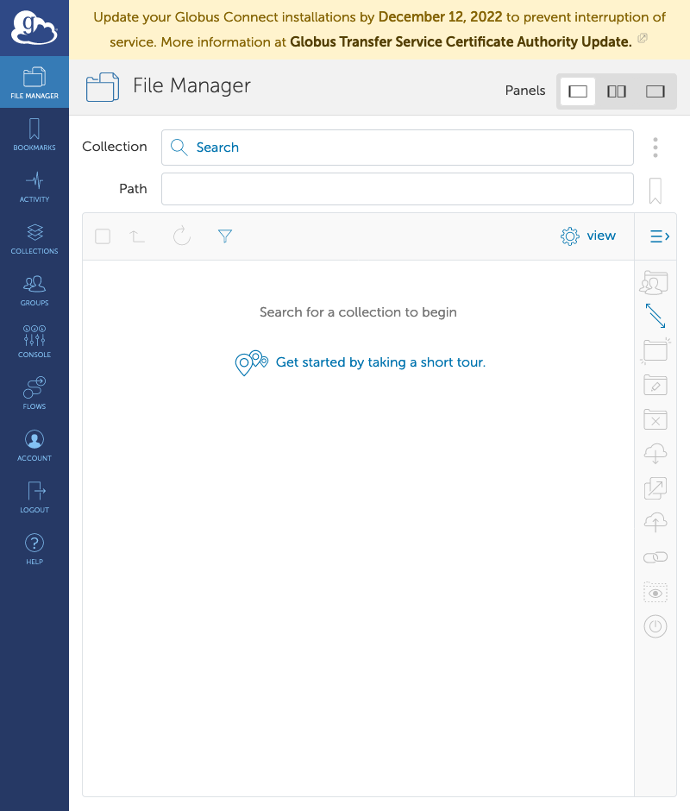
Globus
Designed to transfer large volumes of research data
https://app.globus.org/
Authentication depends on your organisation – please contact your site manager for details
Notes:
For members of RFI - ORCID ID needed to create a Globus account and configured by site manager

Slide 32
7. Final Task: Running a Job with GPUs

Slide 33
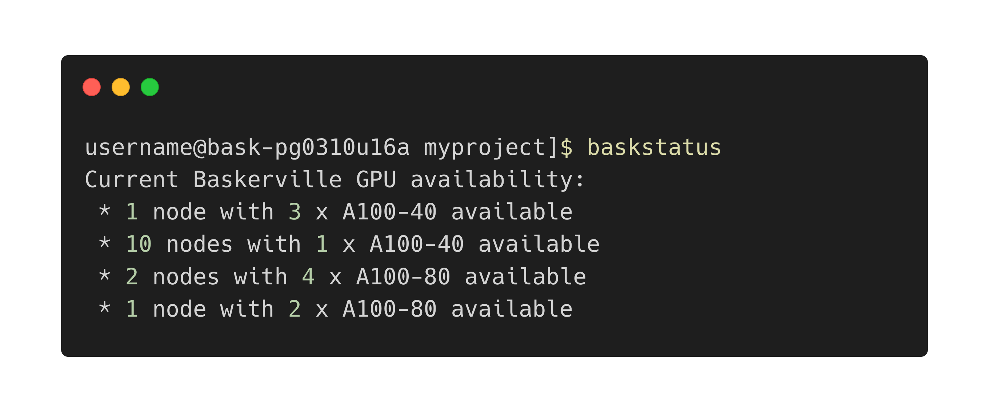
Available GPUs

Slide 34
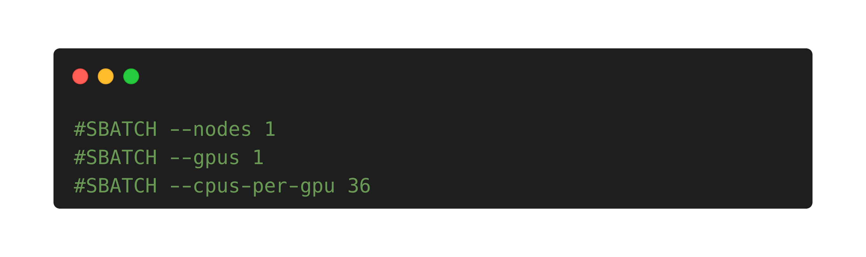
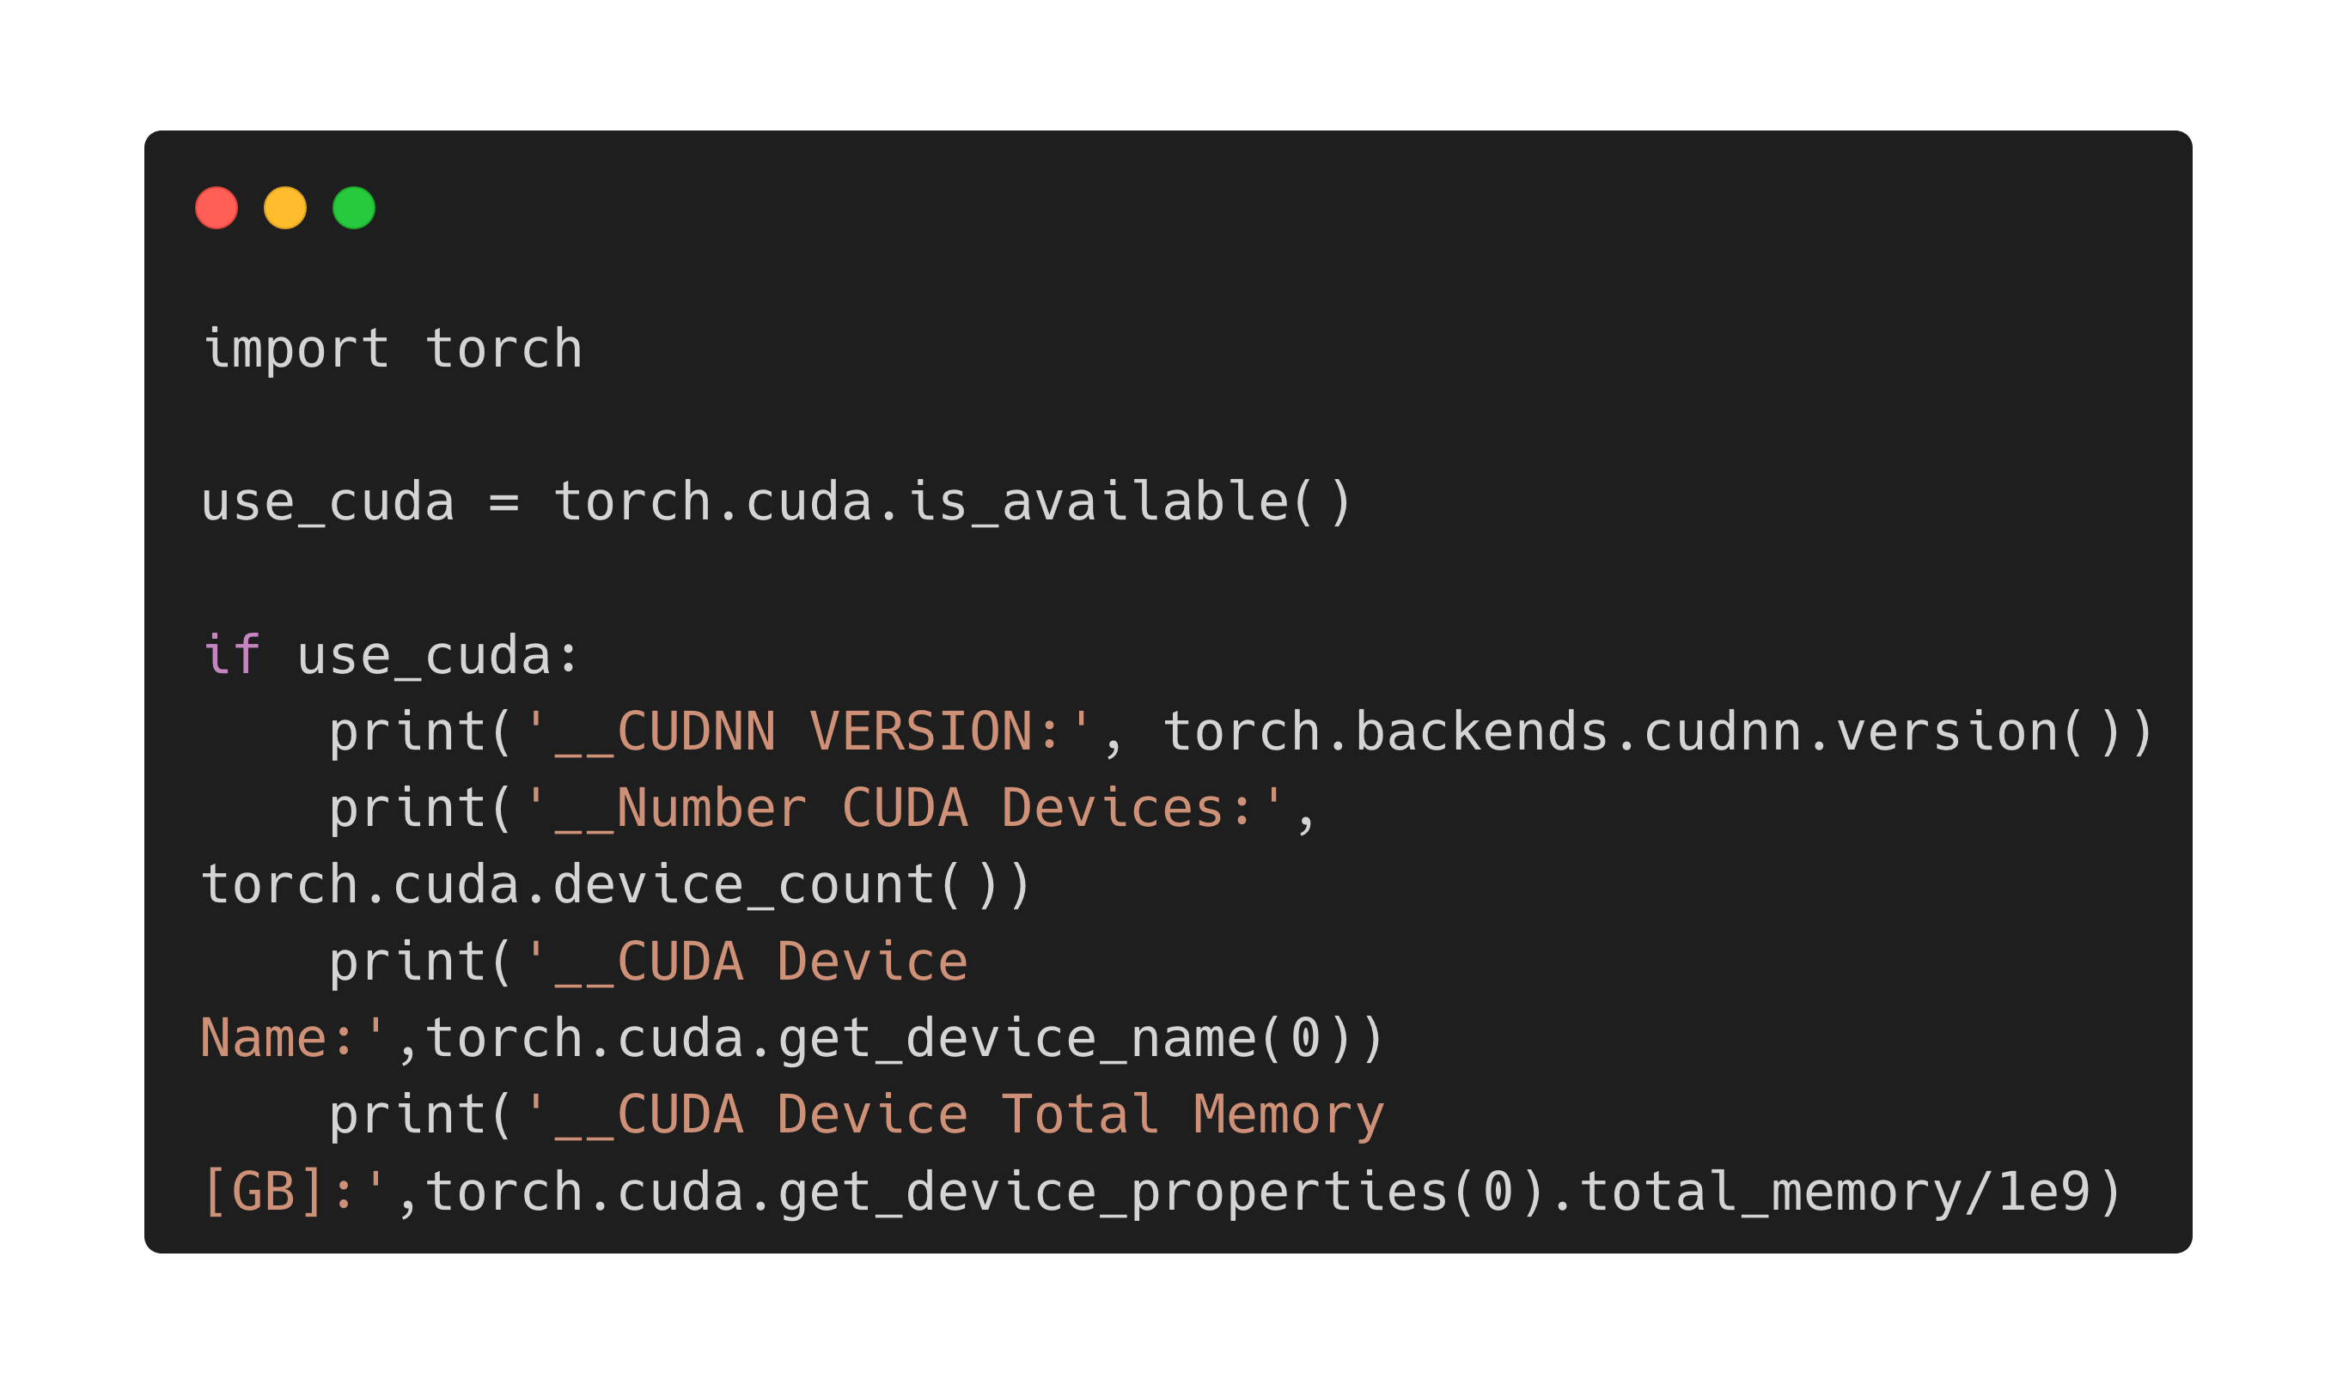
Query GPUs with PyTorch
https://github.com/baskerville-hpc/intro-to-baskerville
Download pytorch_gpu.py from the GitHub repo and rsync to your Baskerville project folder
Write a job script that
specifies your account and QoS, and requests 1 node, 1 GPU, 36 CPUs per GPU
sets up the default environment and module loads PyTorch
executes python pytorch_gpu.py
Submit your job script
Snippet for requesting GPUs
pytorch_gpu.py
Notes:
cuDNN – CUDA Deep Neural Network library

Slide 35
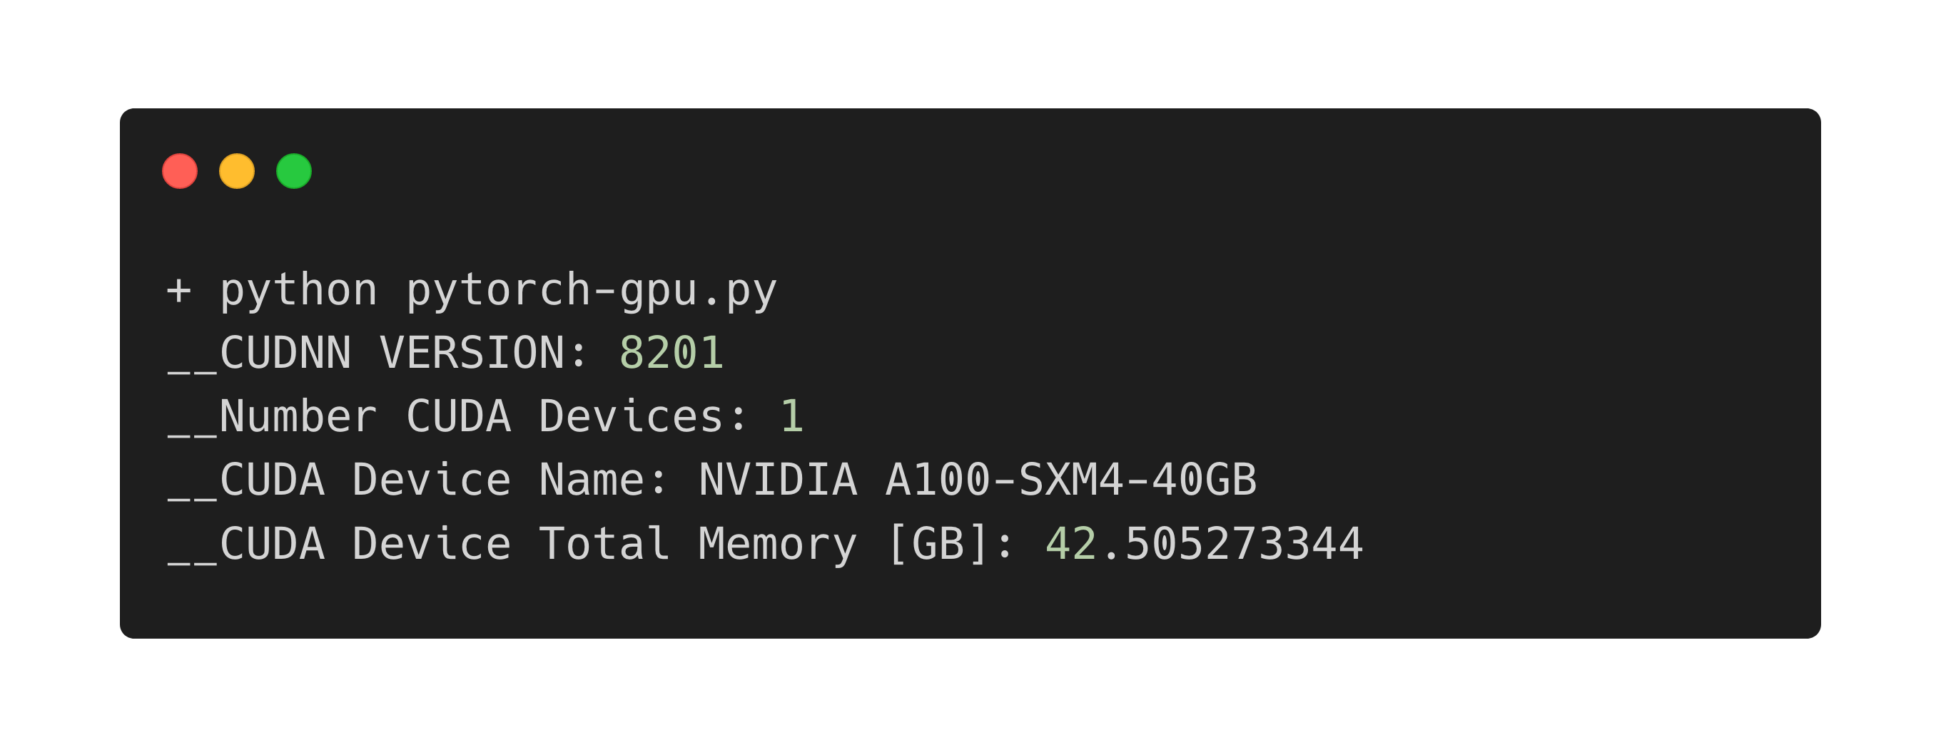
Query GPUs with PyTorch - Result
https://github.com/baskerville-hpc/intro-to-baskerville
Snippet of slurm-<xxxxxx>.out

Slide 36

Congratulations!
Useful links:
https://docs.baskerville.ac.uk/
https://admin.baskerville.ac.uk/
https://apps.baskerville.ac.uk/
https://portal.baskerville.ac.uk/
https://baskerville-hpc/intro-to-baskerville
Email:
baskerville-tier2-support@contacts.bham.ac.uk

